Slide 1
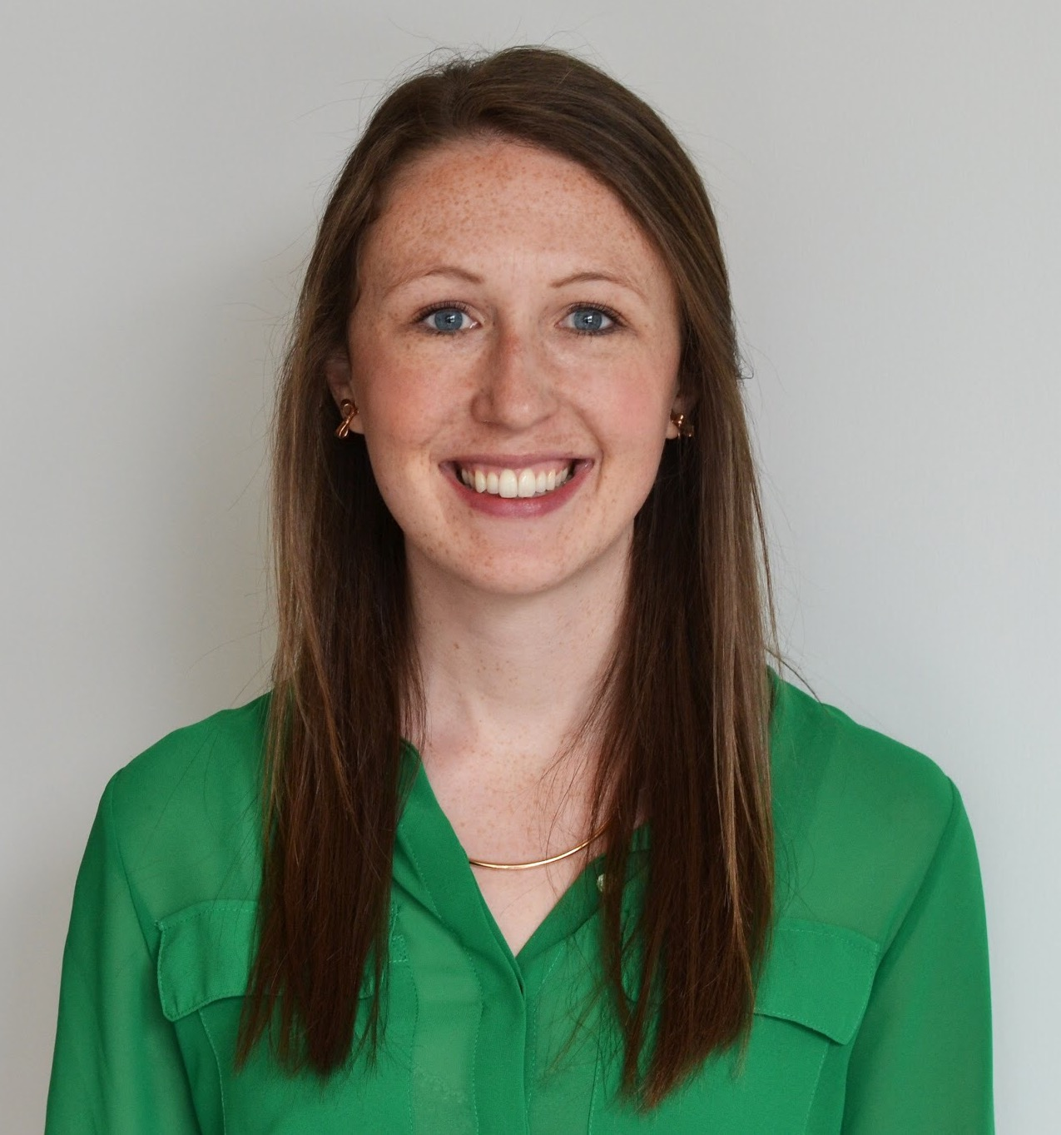
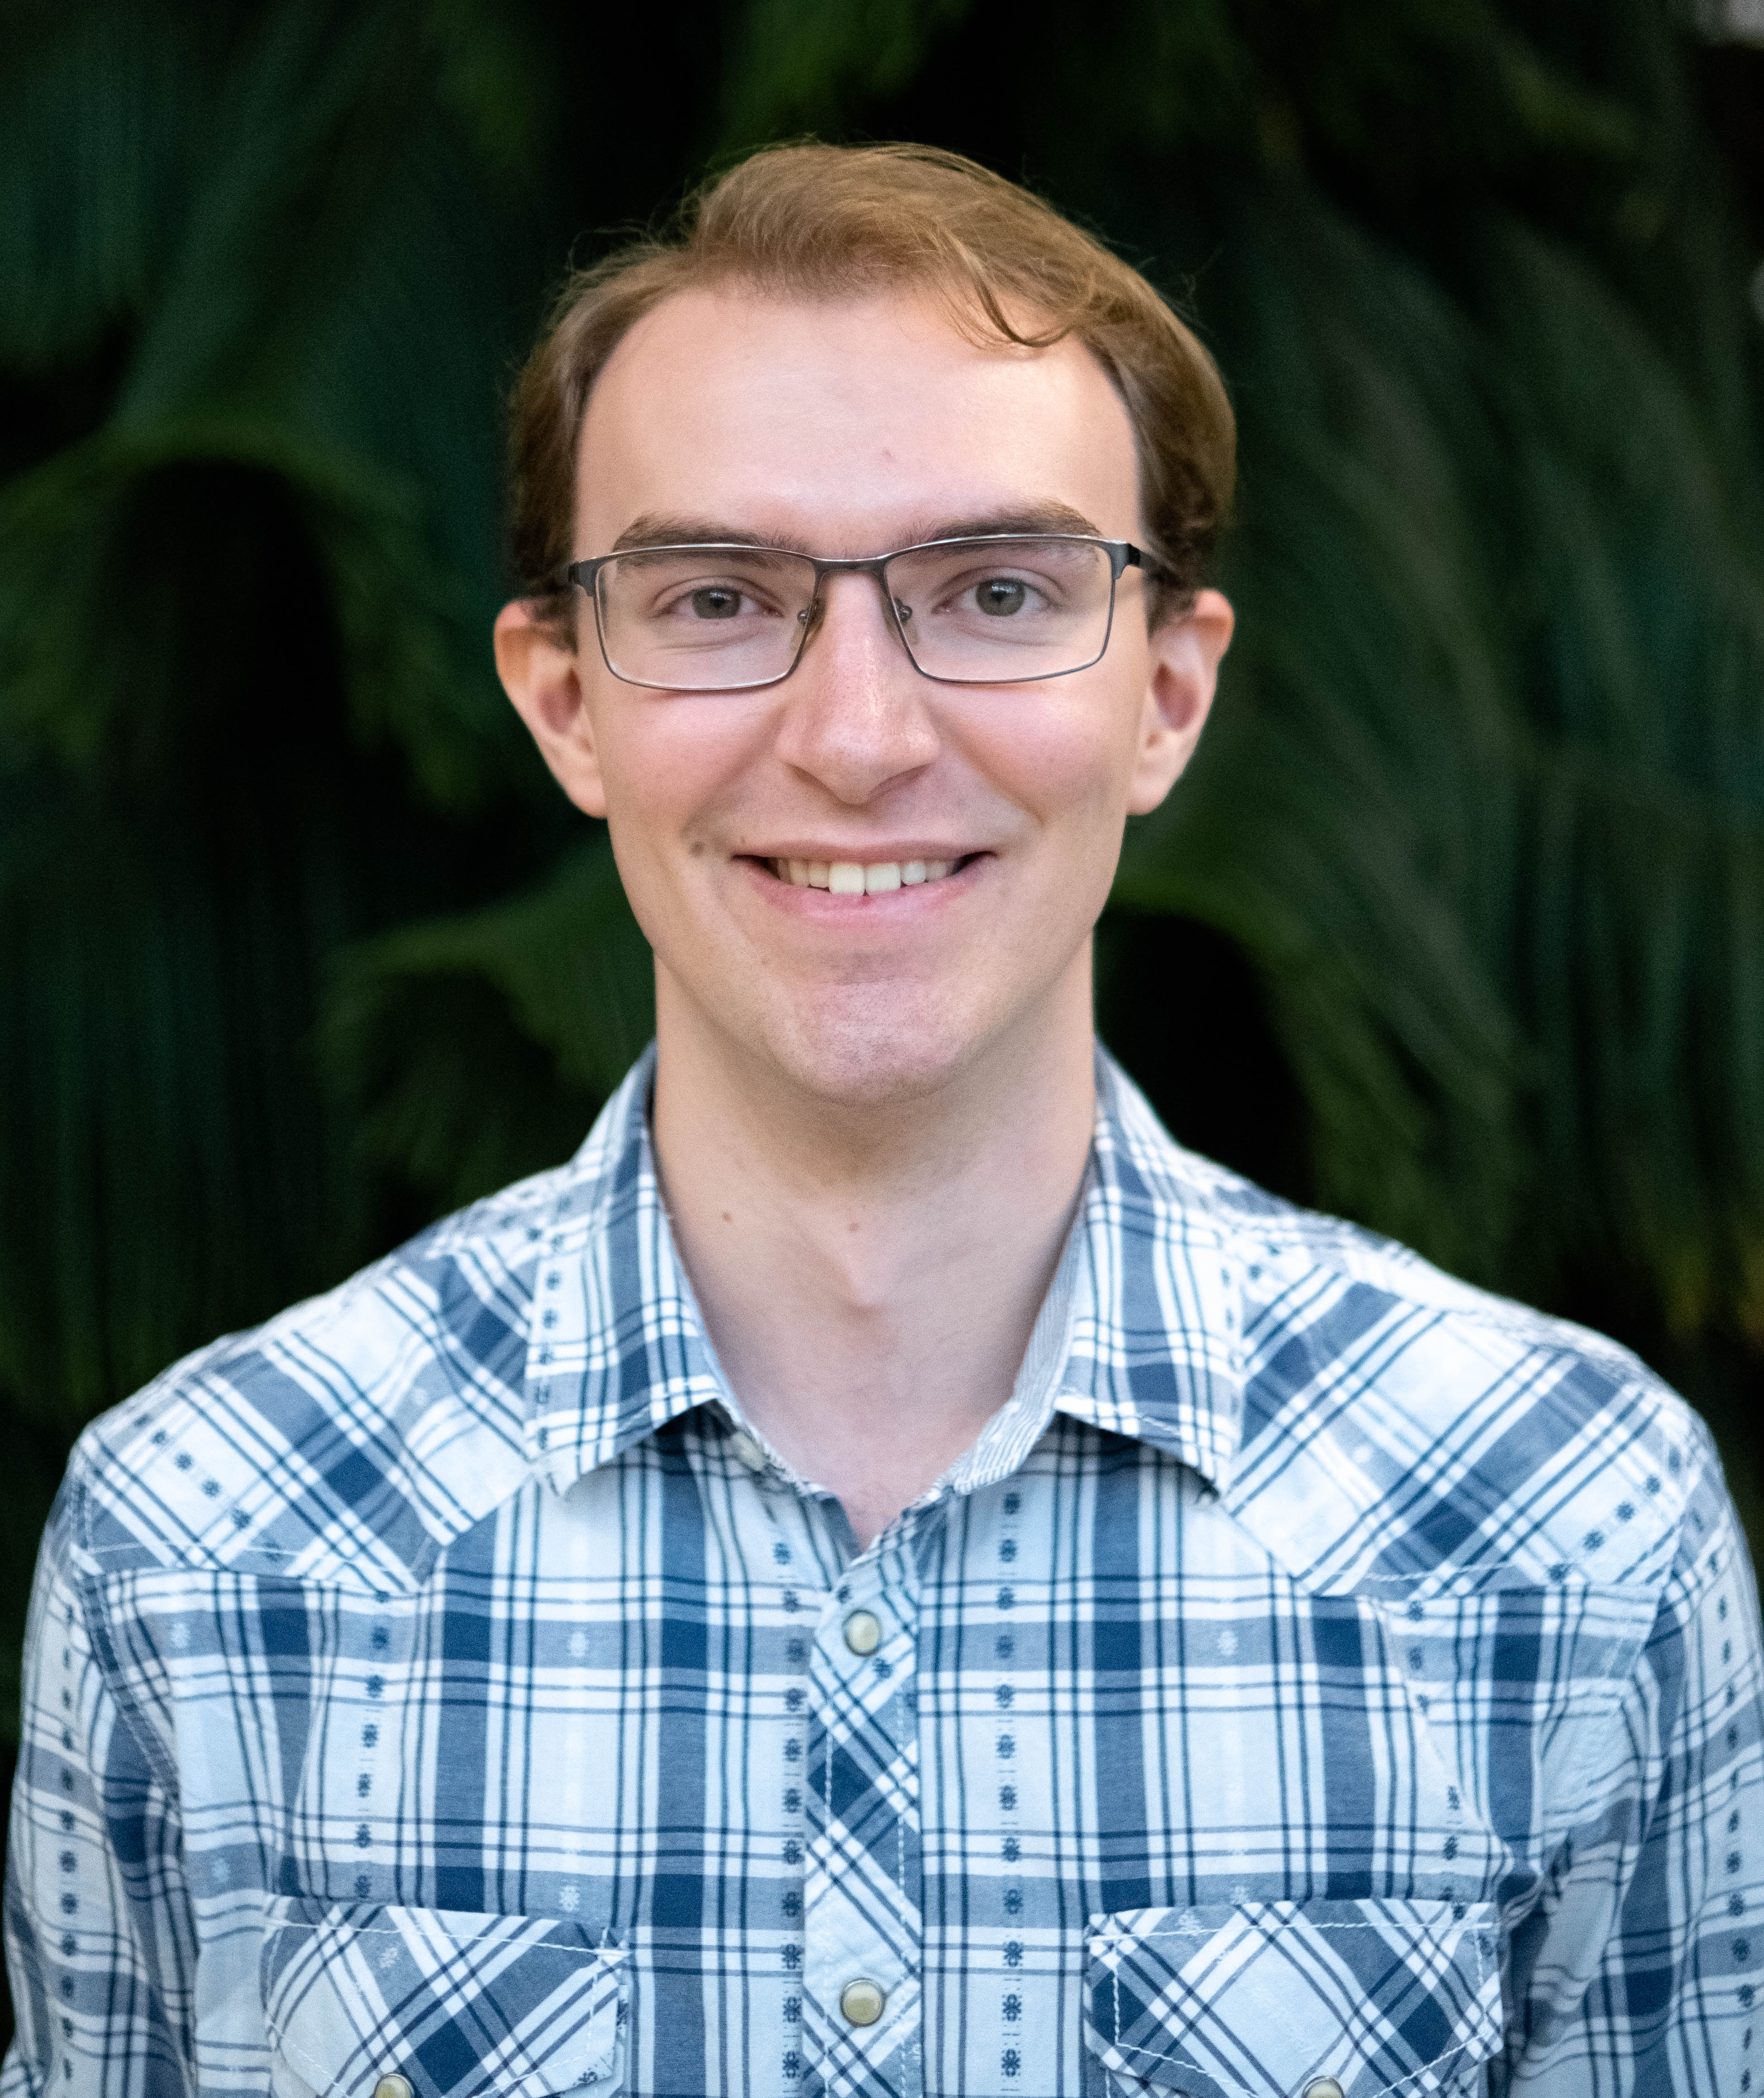
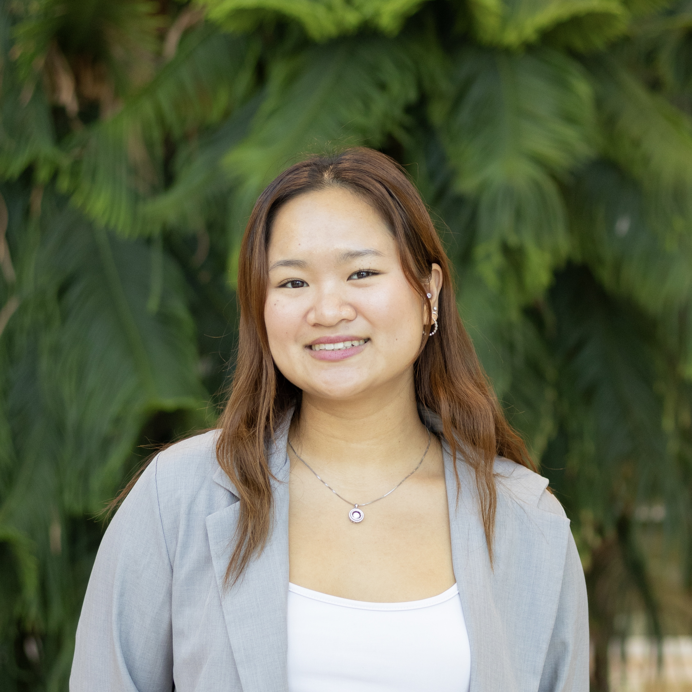

BIOCHEM 3BP3 Practical Bioinformatics in the Genomics Era
Instructor
Teaching Assistants
Dr. Katie Houlahan
Keaton Smith
Tiffany Ta
Mateusz Wlodarski

Slide 2
Practical
Bioinformatics
Genomics

Slide 3
Practical
Bioinformatics
Biological Data | Computer Science | Math | Engineering | Statistics
Genomics

Slide 4
Practical
Bioinformatics
Biological Data | Computer Science | Math | Engineering | Statistics
Genomics
DNA | RNA | Sequencing Data | Genomes

Slide 5
Practical
Problem-Based Learning | Real Experimental Data | Hands-On
Bioinformatics
Biological Data | Computer Science | Math | Engineering | Statistics
Genomics
DNA | RNA | Sequencing Data | Genomes

Slide 6

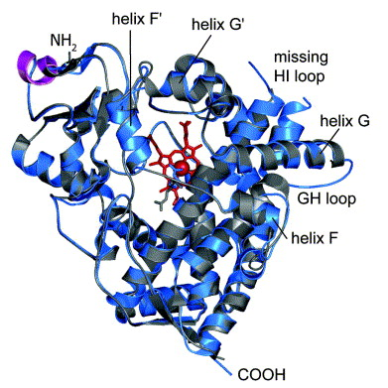

For Example…
Two weeks from now…
Annotation of the toxicological defensome of a Shark

Slide 7
For Example…
By the Reading Break…
Process sequencing data using the command line

Slide 8
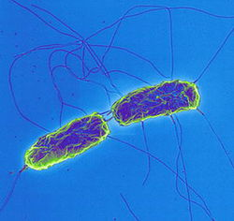
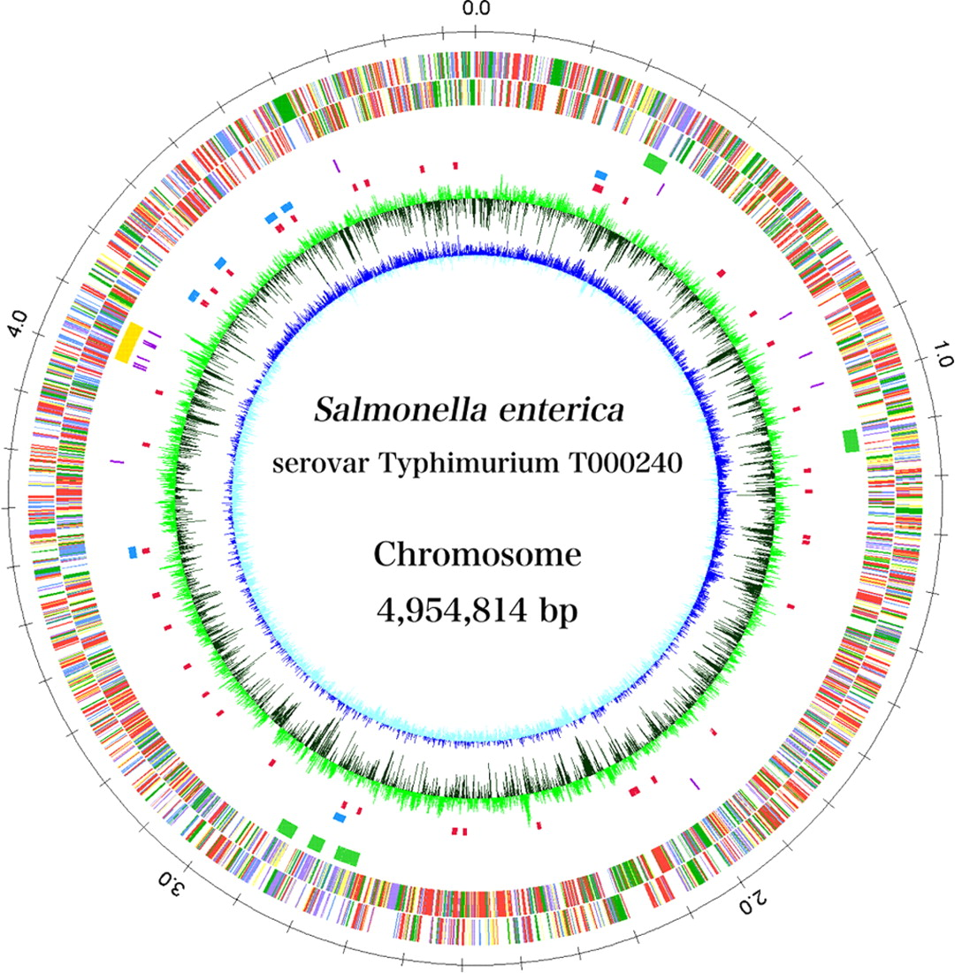
For Example…
Early November…
Use genomics to analyze a pathogen outbreak

Slide 9
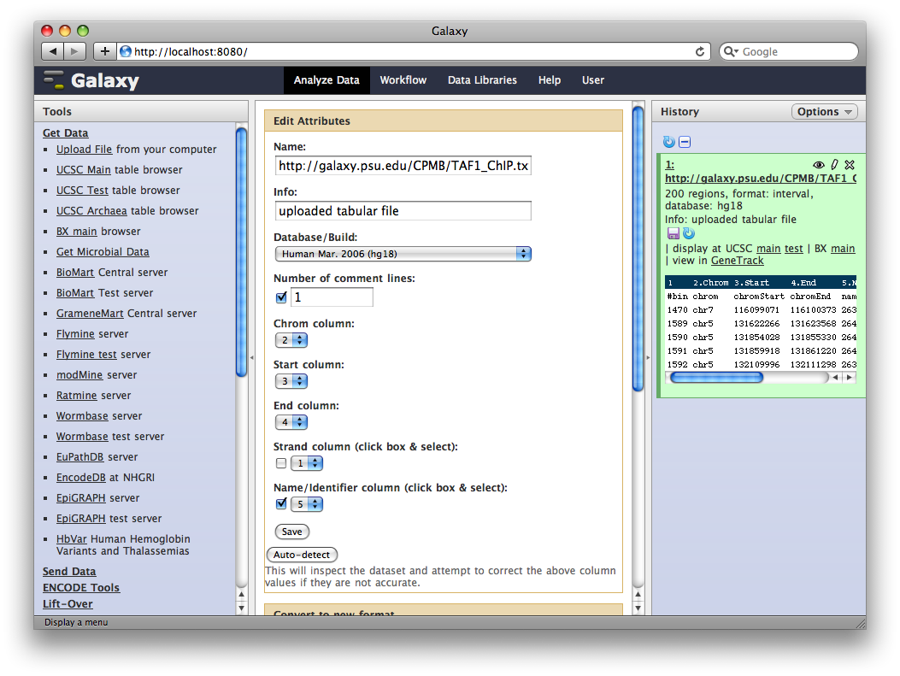
For Example…
By the end of November…
Use cloud computing to analyze gene expression data

Slide 10
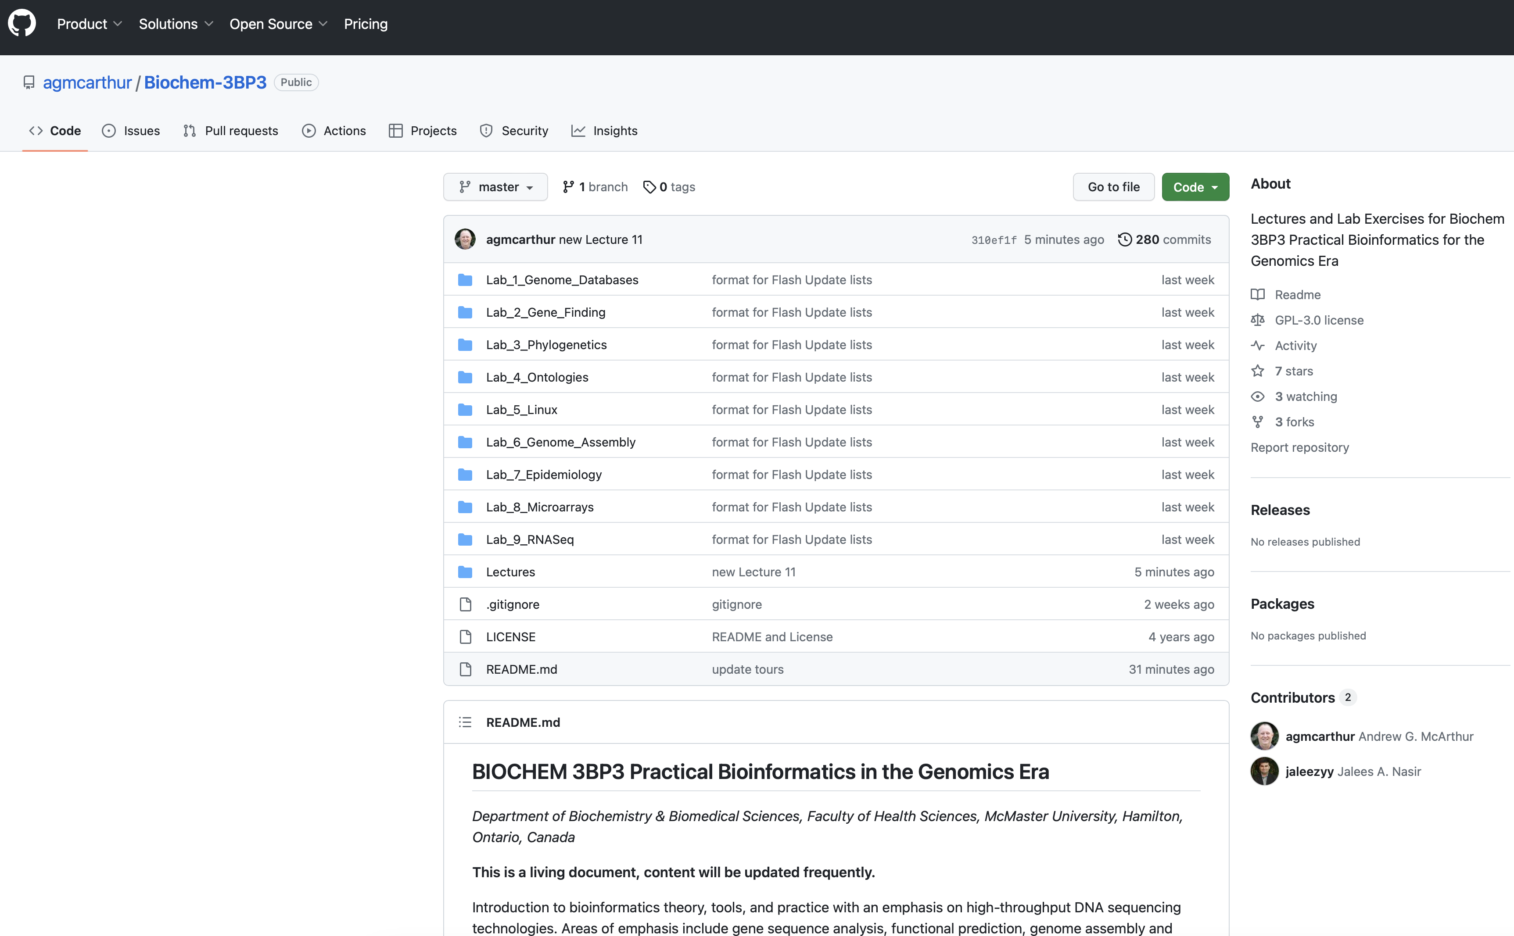
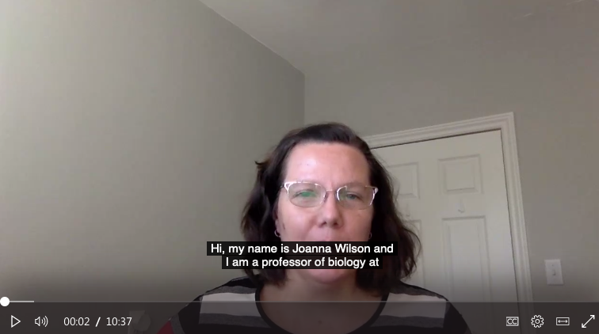
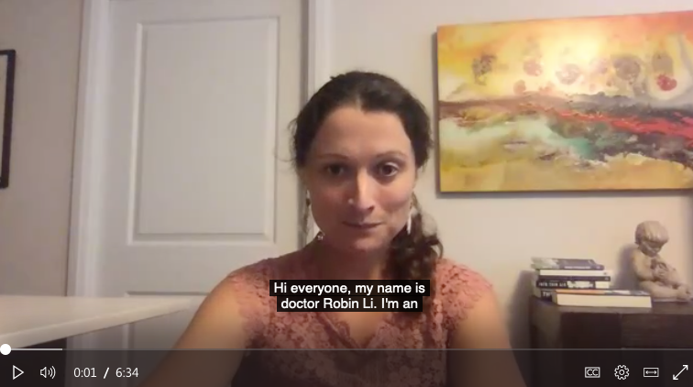
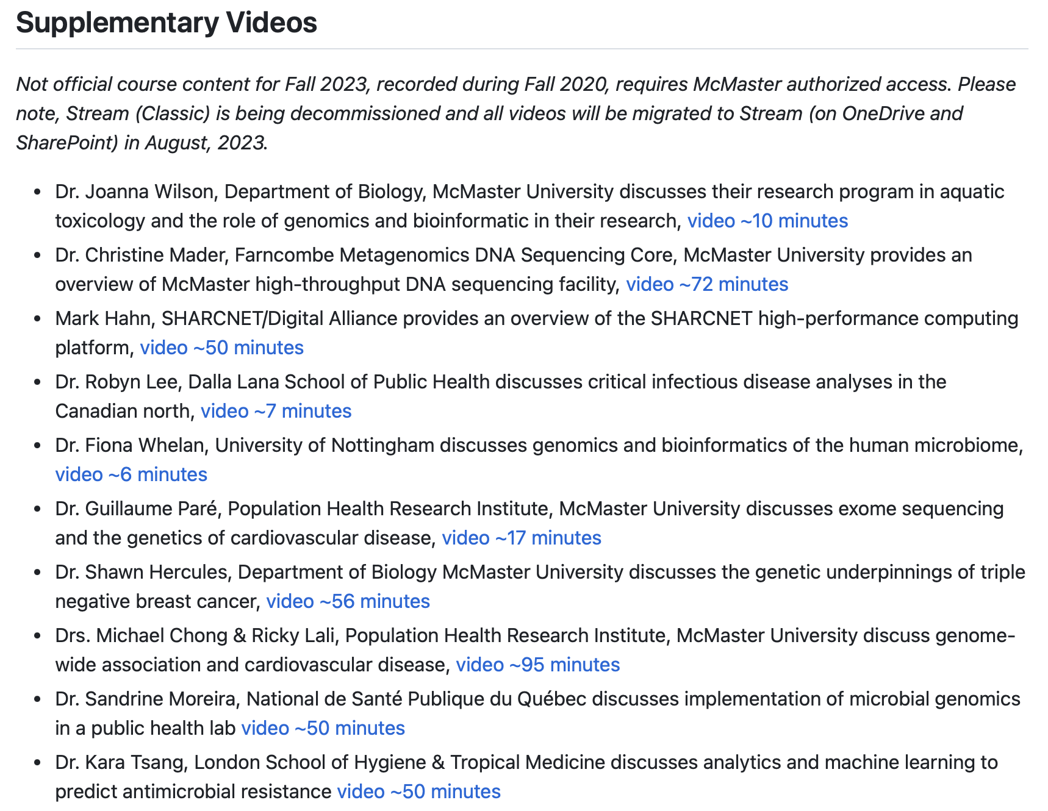
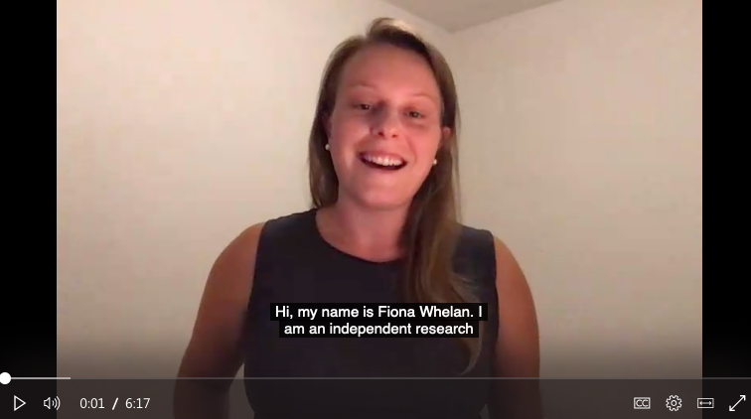
Hybrid Learning…

Slide 11

No Computer Science Experience Required
Registered students are from iSci, Biochemistry, Biomedical Discovery & Commercialization, Honours Health Sciences, Life Sciences, Medical & Biological Physics
The course goal is to teach you the theory and practice of analysis of real-world research data in the biological / biomedical sciences.
The course will provide an introduction to Bioinformatics plus expand your research toolkit.

Slide 12
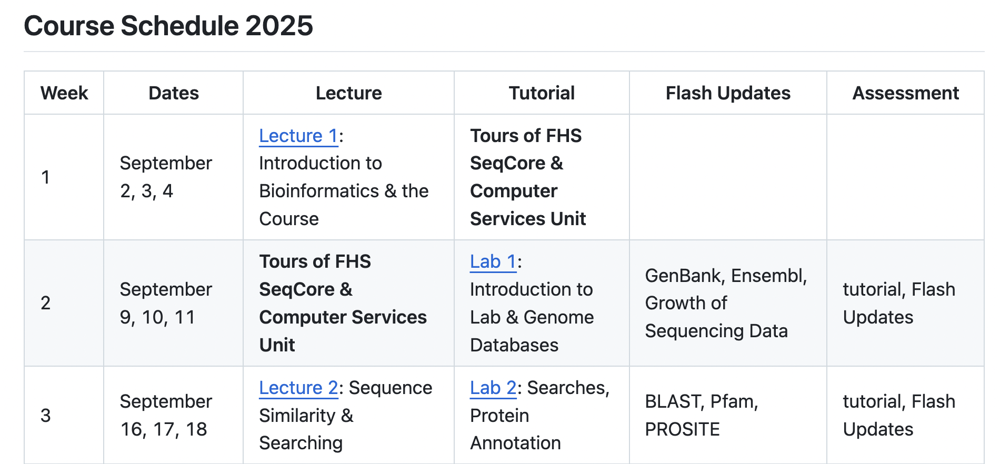
Course Structure
Electronic Resources
We will use Avenue to Learn for submitting assessments and grading
Guest lecture material, course documents, supplementary tutorial files
GitHub: https://github.com/agmcarthur/Biochem-3BP3
Schedule
Tutorials
Flash Update details
Lecture PowerPoint files
Supplementary Videos
MS Teams for asynchronous communication
All visual lecture and lab material (e.g., Powerpoint, PDF) will be provided in advance on A2L and/or GitHub.
All lectures will be recorded and provided as videos in a timely manner to the entire class.
There are no in-class evaluations, all assignments are take-home and not due for at least 7 days, including lecture quizzes.
The exception are the 10-minute Flash Update presentations, which are scheduled for each student on a specific date.
There are no tests or exams in this course.

Slide 13
Course Structure
Weekly Modules - Tuesdays
Traditional lecture to introduce the topic and outline the key objectives
Overview and (optional) readings available in GitHub: https://github.com/agmcarthur/Biochem-3BP3
PowerPoint files available on GitHub
GitHub may provide links to supplementary videos
All lectures will be recorded and provided as videos in a timely manner to the entire class

Slide 14
Course Structure
Weekly Modules – Wednesdays or Thursdays
A core take-home assignment due on Avenue to Learn in 10 days
3 students give a 10 minute “Flash Update” presentation each week
TAs overview the Tutorials: https://github.com/agmcarthur/Biochem-3BP3
AL2 Quizzes used for submission of Tutorial answers + multiple choice questions
Lectures | Tuesdays | 4:30 pm-5:20 pm | PGCLL M12 | Dr. Houlahan
Tutorial T01 | Wednesdays | 10:30 am-12:20 pm | BSB B139 | Keaton Smith
Tutorial T02 | Thursdays | 10:30 am-12:20pm | BSB B139 | Tiffany Ta
Tutorial T03 | Thursdays | 8:30 am-10:20am | PGCLL M25 | Mateusz Wlodarski

Slide 15
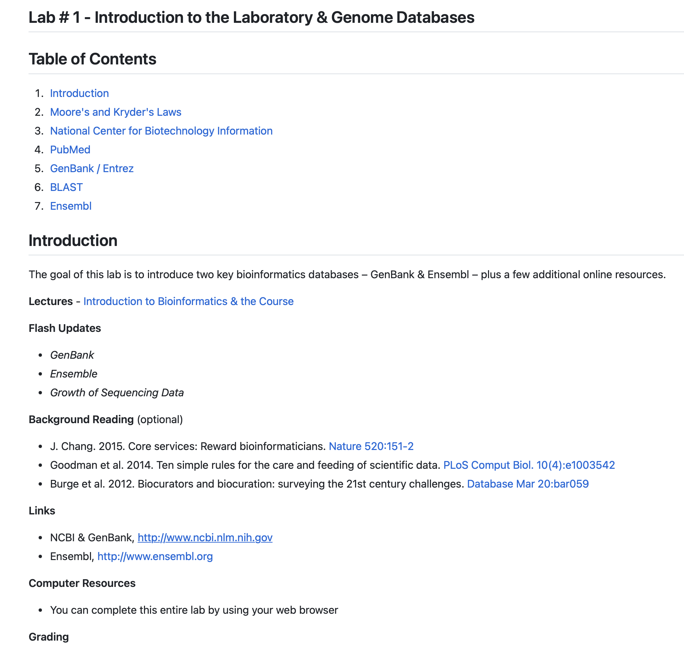
Course Structure

Slide 16
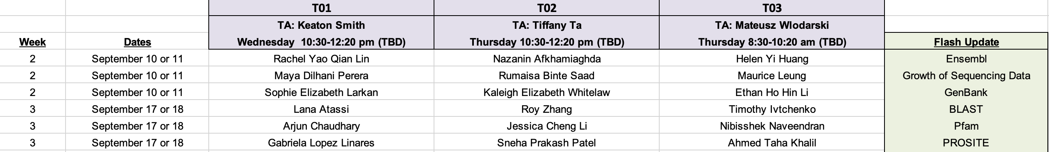
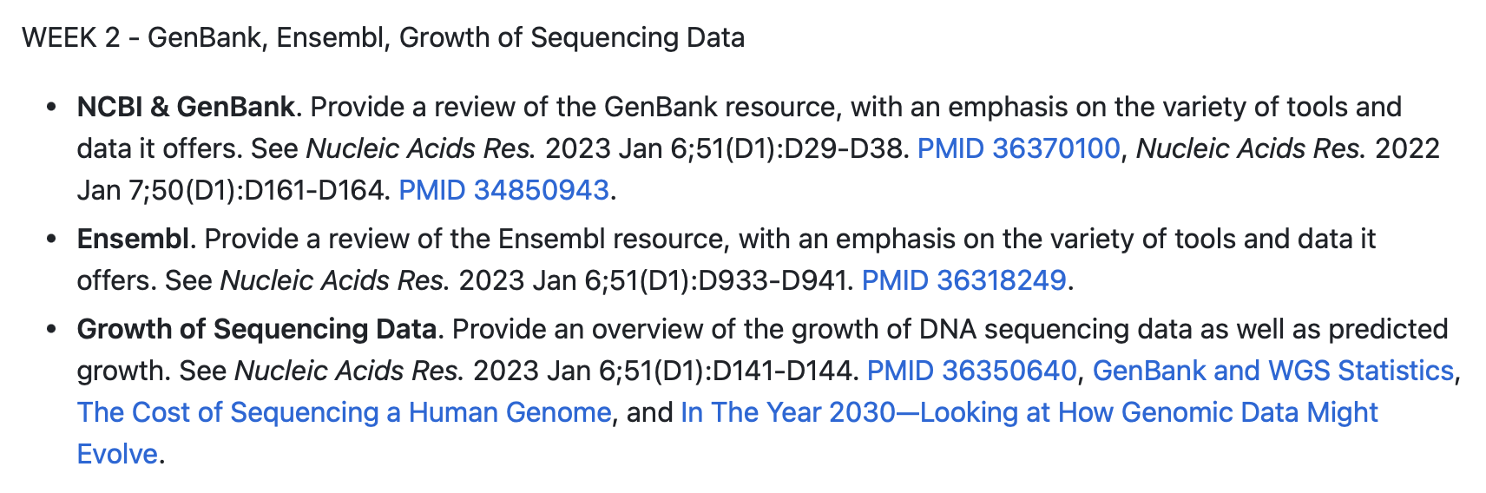
Flash Updates
See the Flash Update Presentation Schedule on A2L
A Flash Update is a 10 minute PowerPoint presentation summarizing the key points of the assigned topic
Must include 3 https://kahoot.com questions!
PowerPoint file must be uploaded to Avenue to Learn by start of your tutorial session!
A2L
GitHub

Slide 17
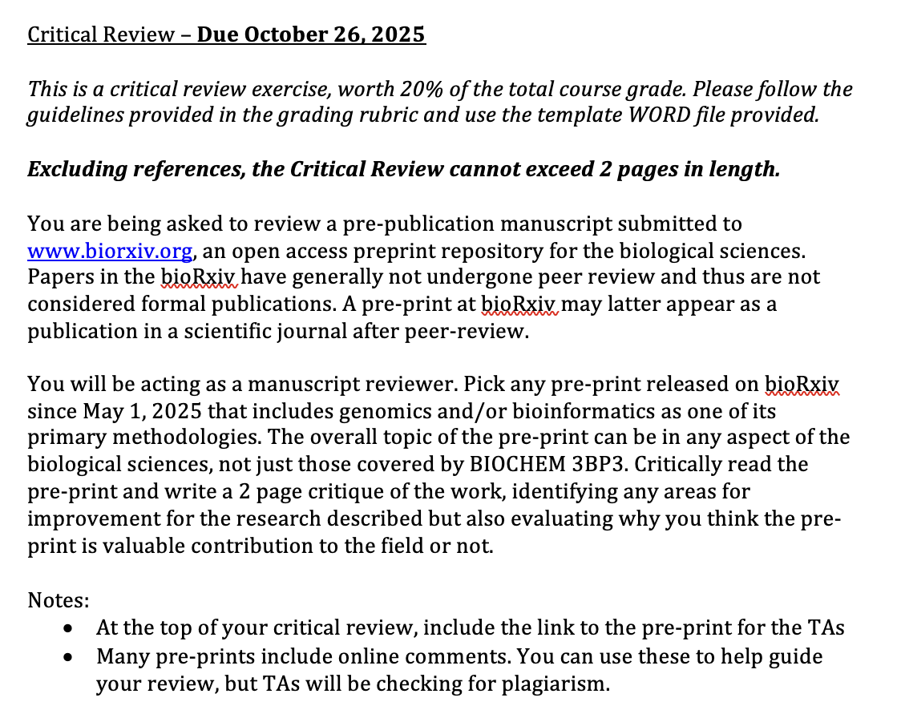

Critical Review
Post your preprint on MS Teams

Slide 18
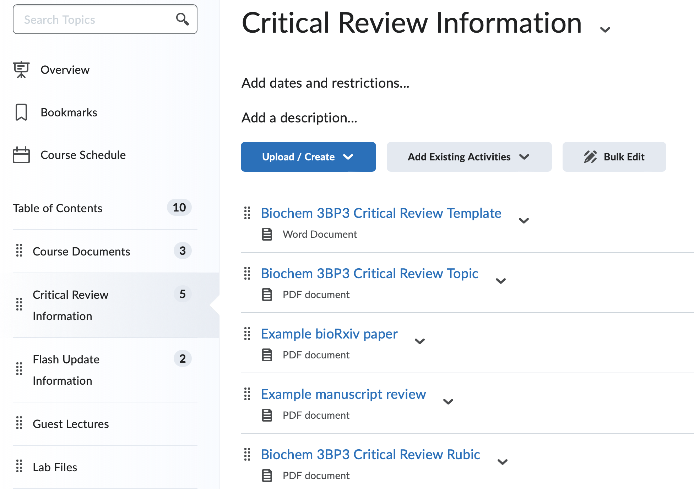
More Details

Slide 19
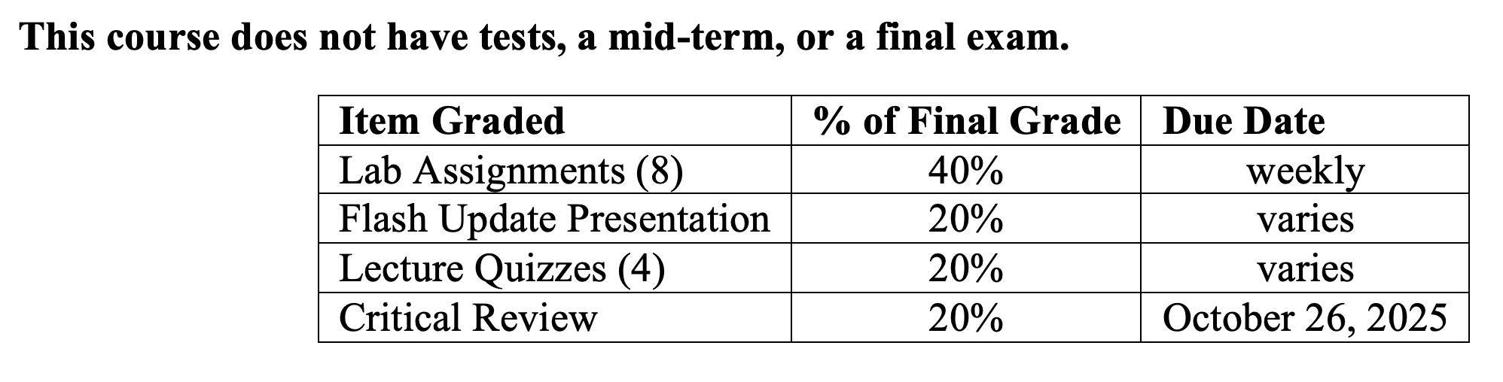
Grading
No textbook – primary literature only
TAs will post their office hours– use MS Teams too!
All work submitted via Avenue to Learn
Late penalties will be assessed at 10% per day, including weekends.
After 4 days, the assignment will not be accepted and a grade of 0 will be assigned.
MSAF (Self Report) for absences not longer than 3 days & work worth not greater than 25% of the final grade
MSAF (Administrative) for absences longer than 3 days or work worth more than 25% of the final grade

Slide 20




About Us – Katie
Chemical Biology Co-op

Slide 21



About Us – Katie
PhD in Cancer Genomics

Slide 22

About Us – Katie
Postdoc

Slide 23
About Us – Katie
Started in 2024
Cancer Research Chair (Tier 2) in Computational Oncology

Slide 24
About Us - TAs
Keaton Smith
Tiffany Ta
Mateusz Wlodarski

Slide 25
A ‘Living’ Course
Each term – evolving lectures, data, tools
Problem-Based Learning, Inverted Teaching Style
Real Experimental Data
Not everything is going to go perfectly
Experimental data is messy – there may not be an “answer”
The schedule & tutorial details are tentative
Being Successful
Attend all live sessions, watch all recorded materials
Ask questions and use your Teaching Assistant!

Slide 26

A few things…
All readings can be found on PubMed via a McMaster IP address or via the McMaster LibAccess portal if off campus: https://libraryssl.lib.mcmaster.ca (E-Journals)
Some aspects of the course will require use of McMaster’s Virtual Private Network: https://uts.mcmaster.ca/services/computers-printers-and-software/virtual-private-networking/

Slide 27
Using PubMed

Slide 28
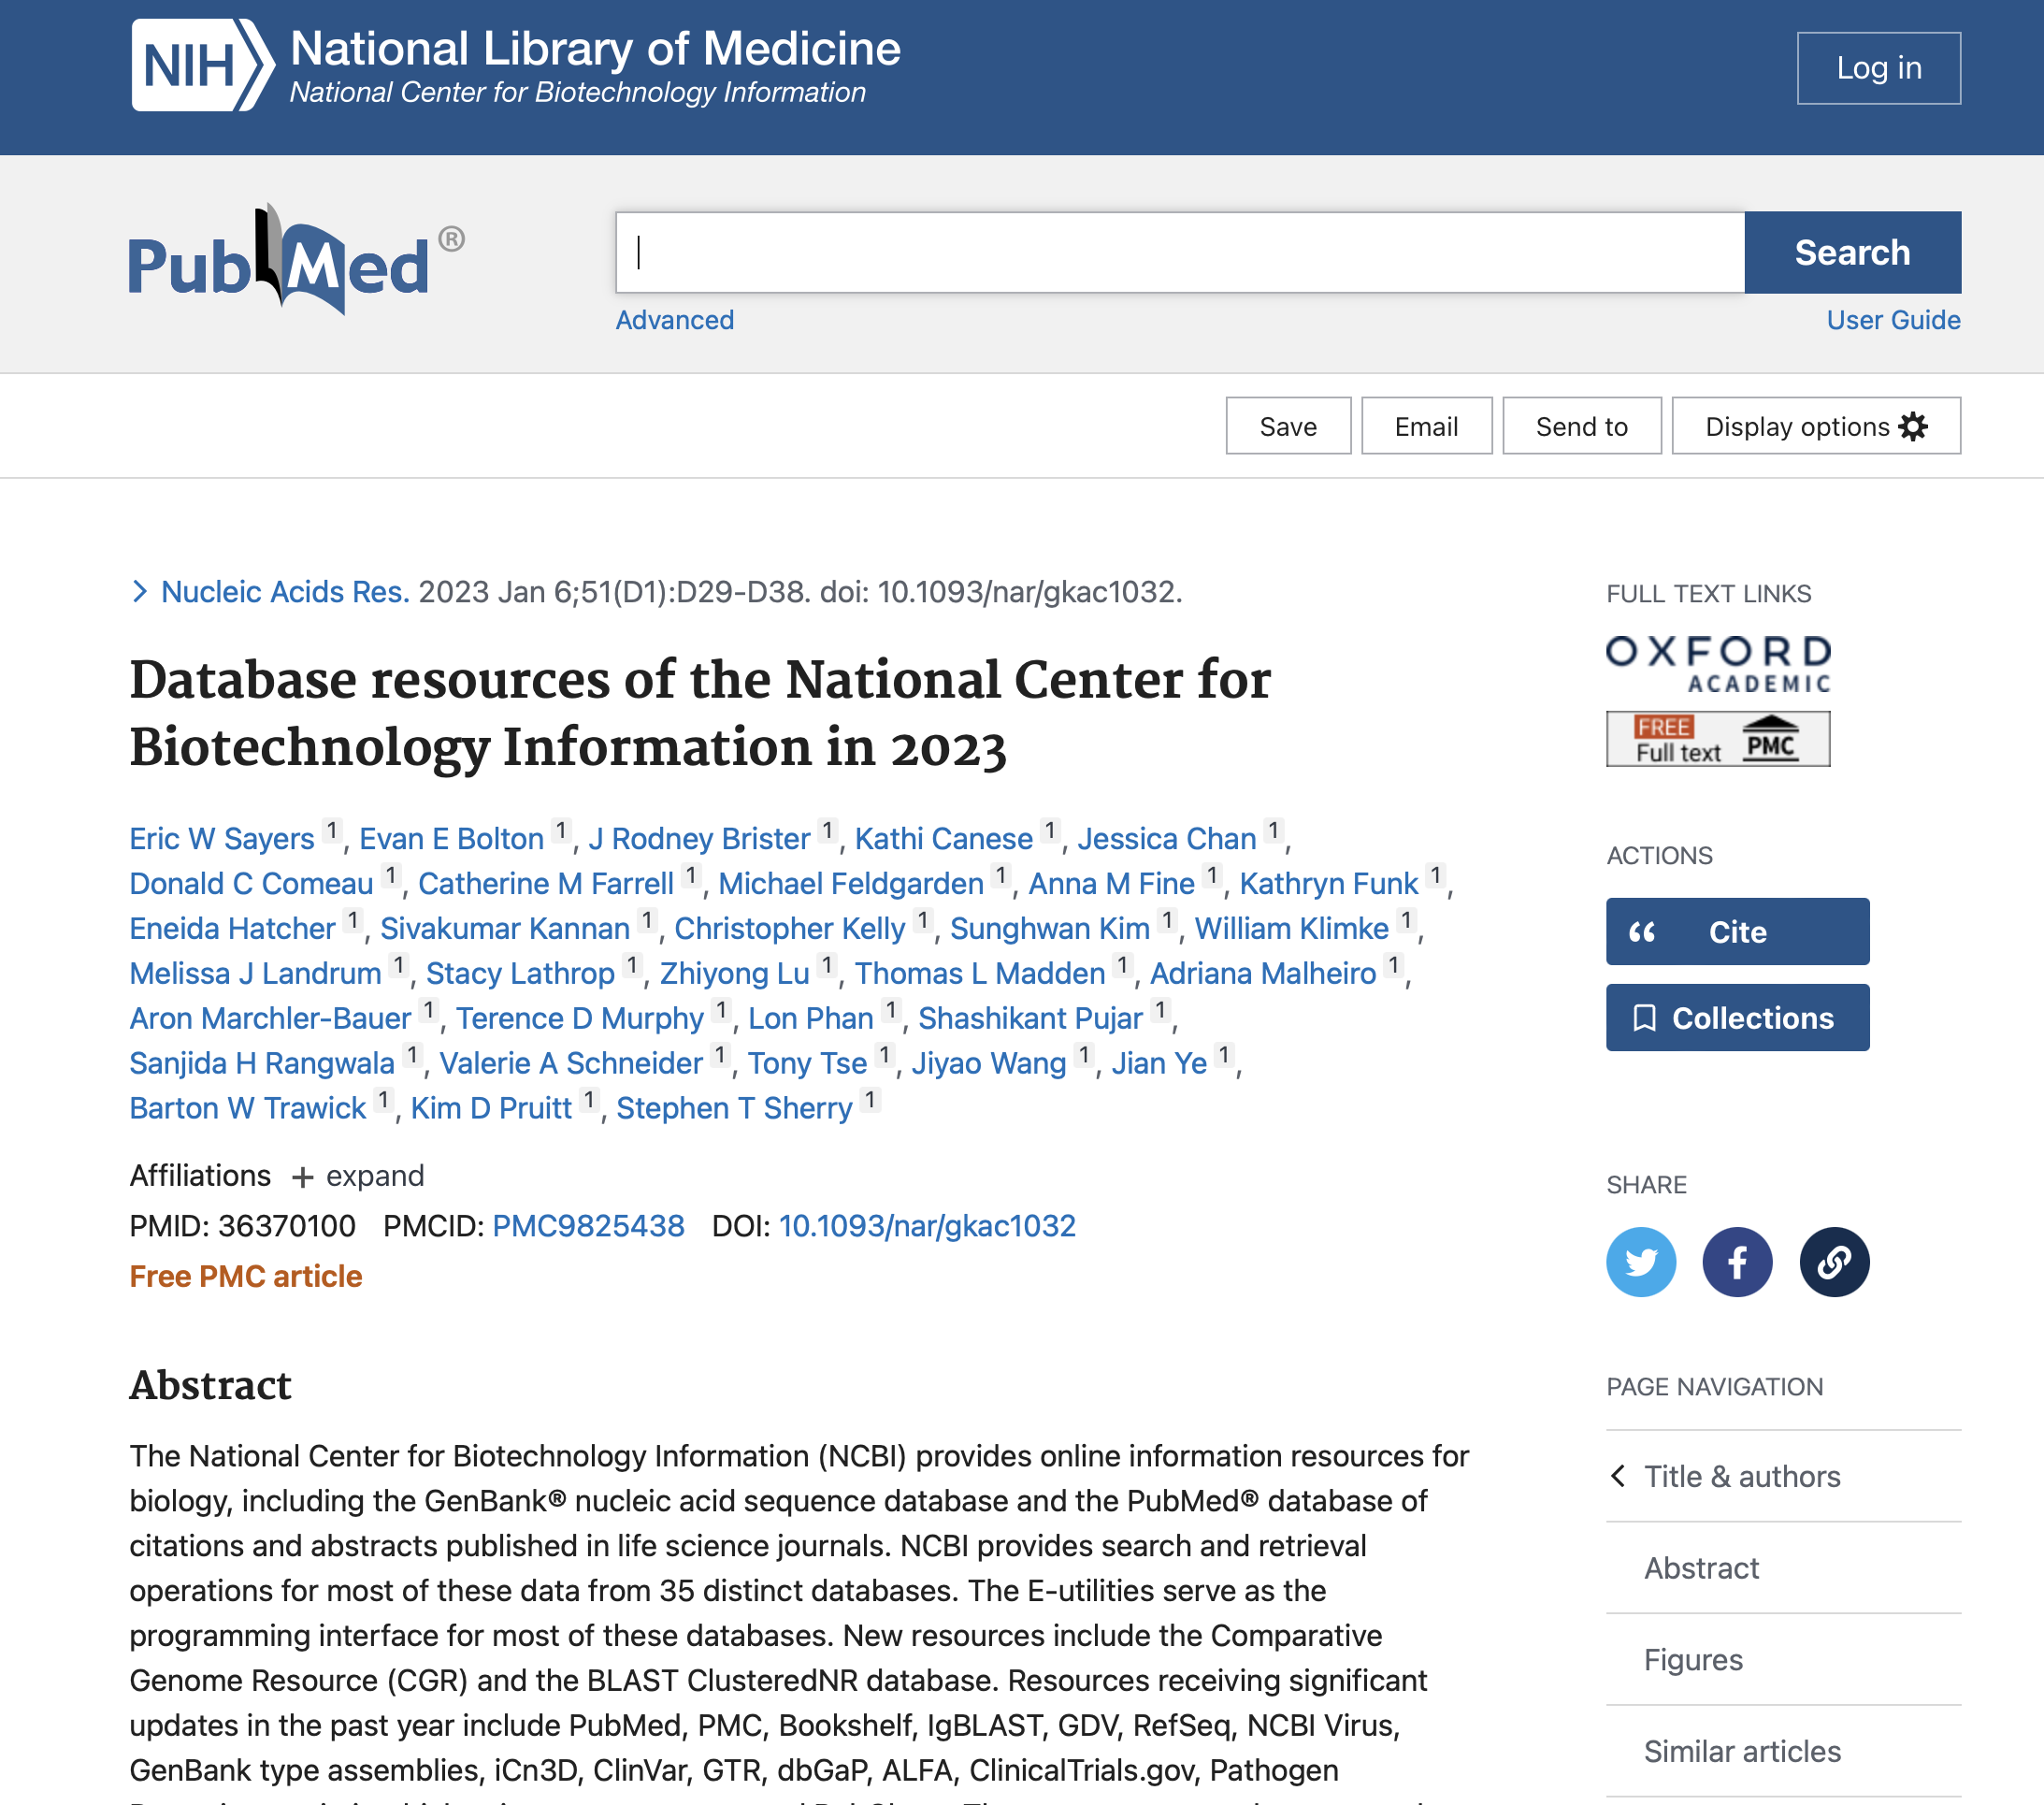
Using PubMed

Slide 29
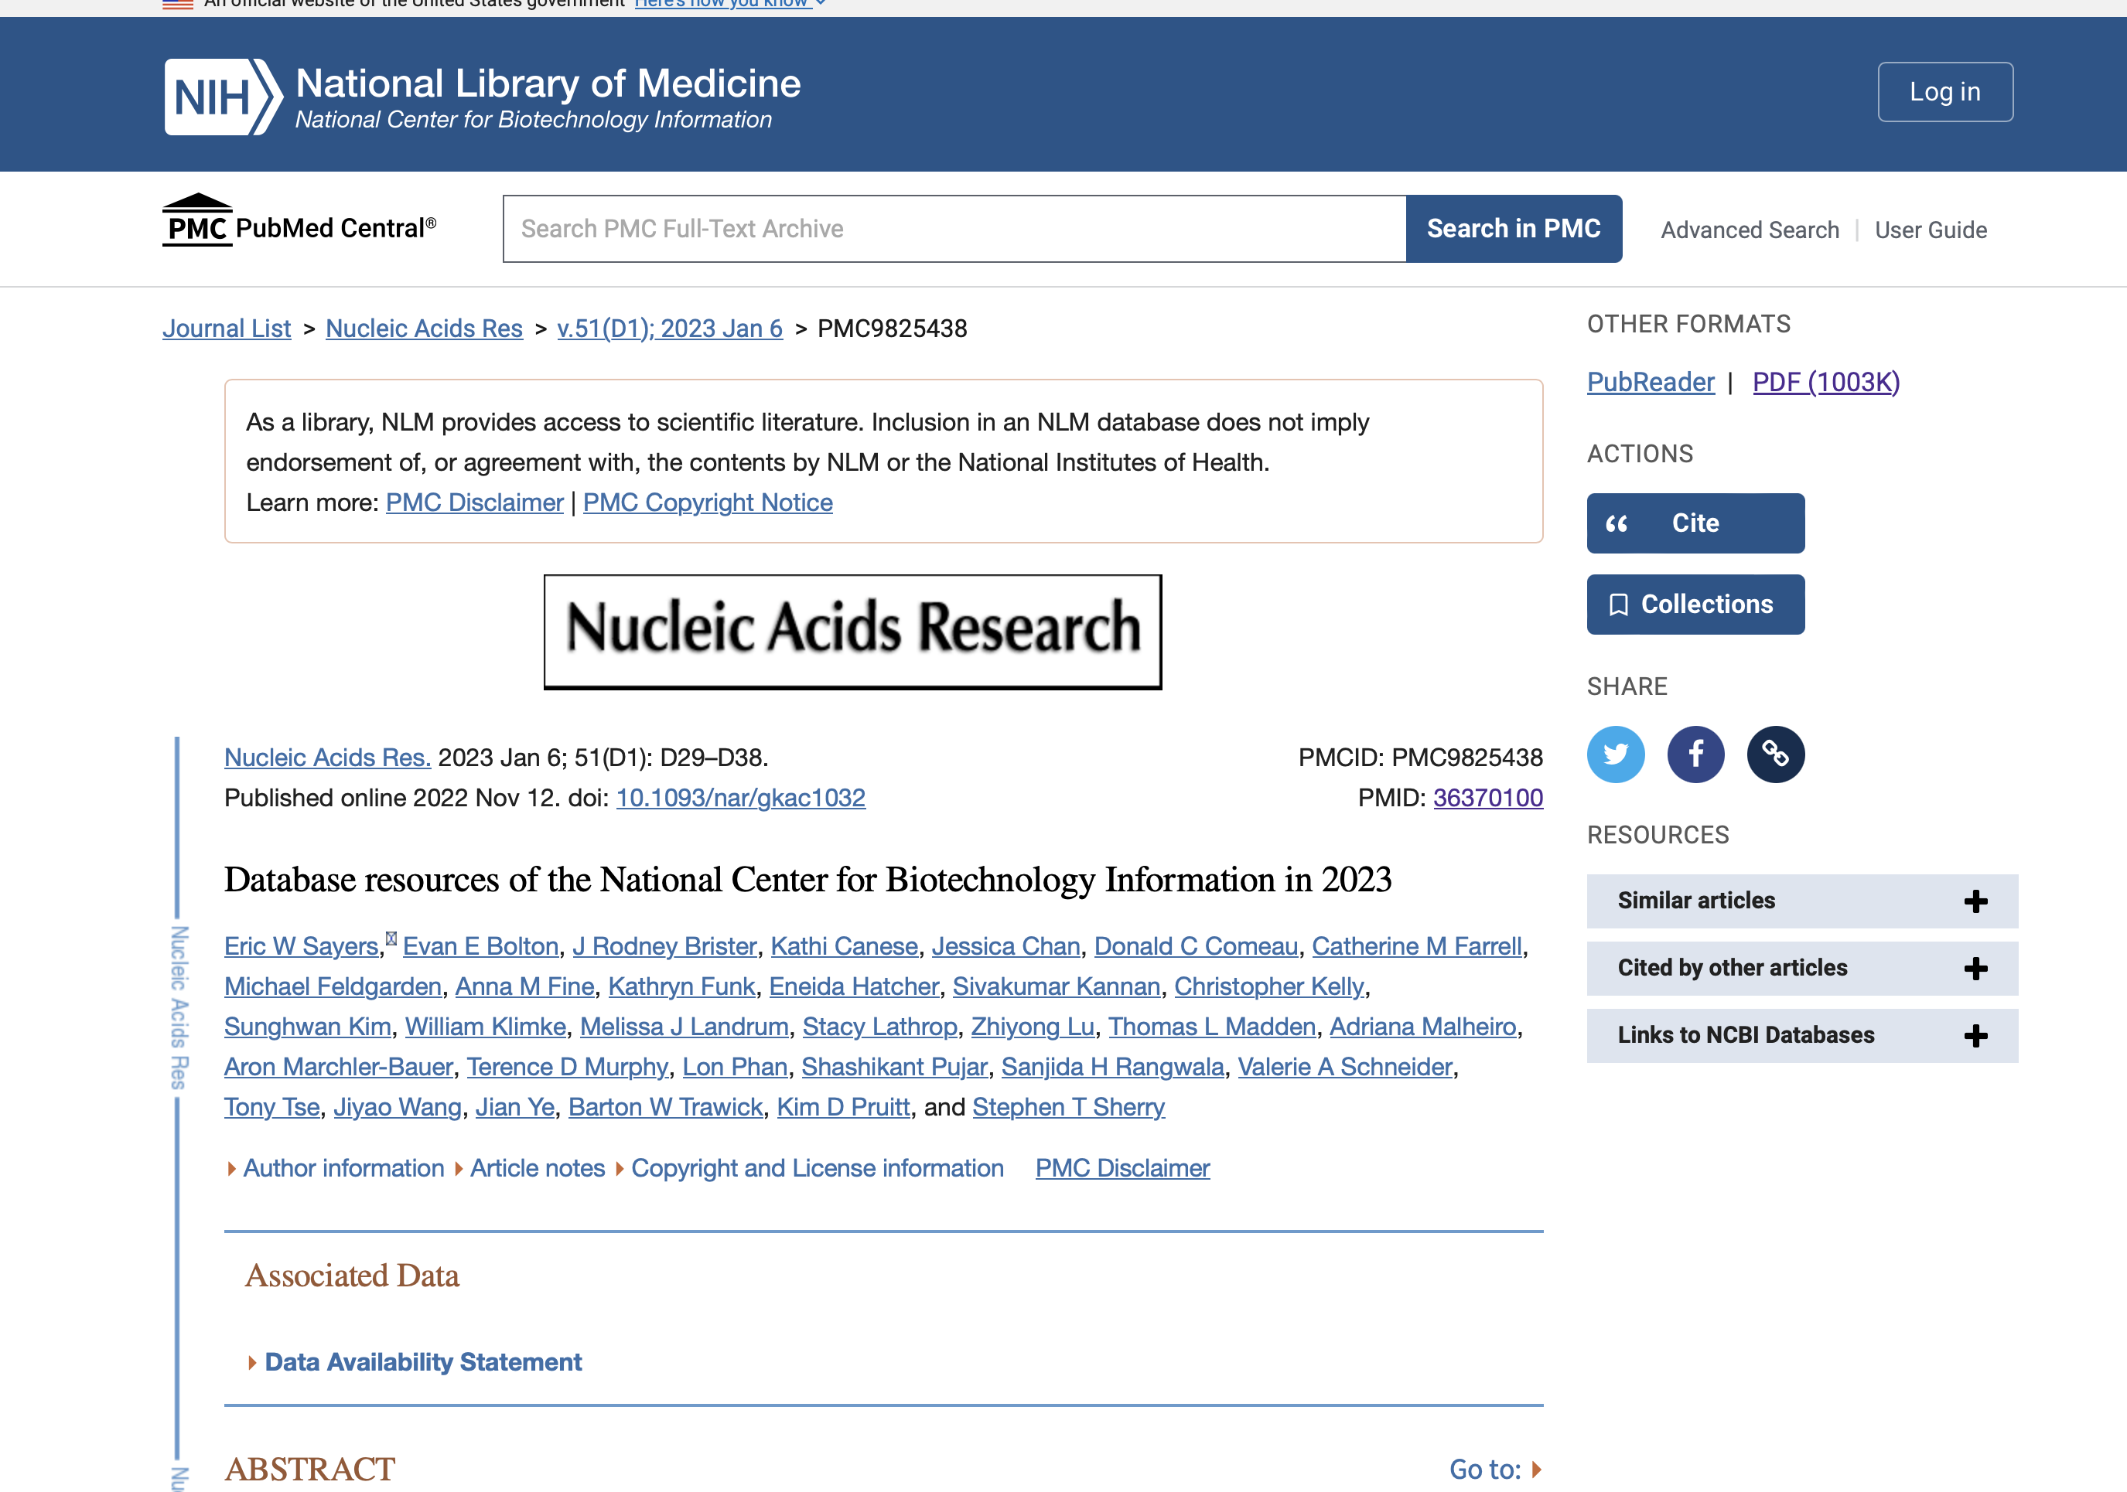
Using PubMed

Slide 30
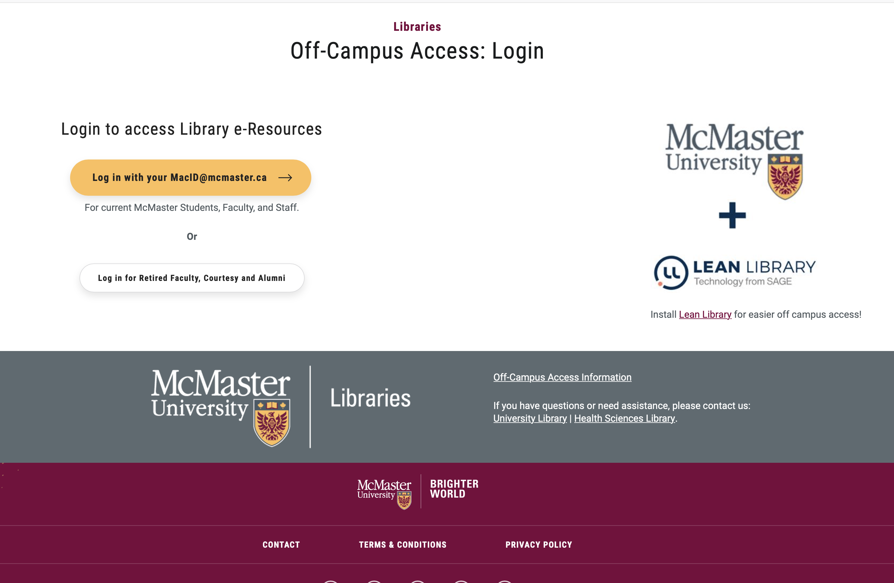
Using PubMed
https://libraryssl.lib.mcmaster.ca

Slide 31
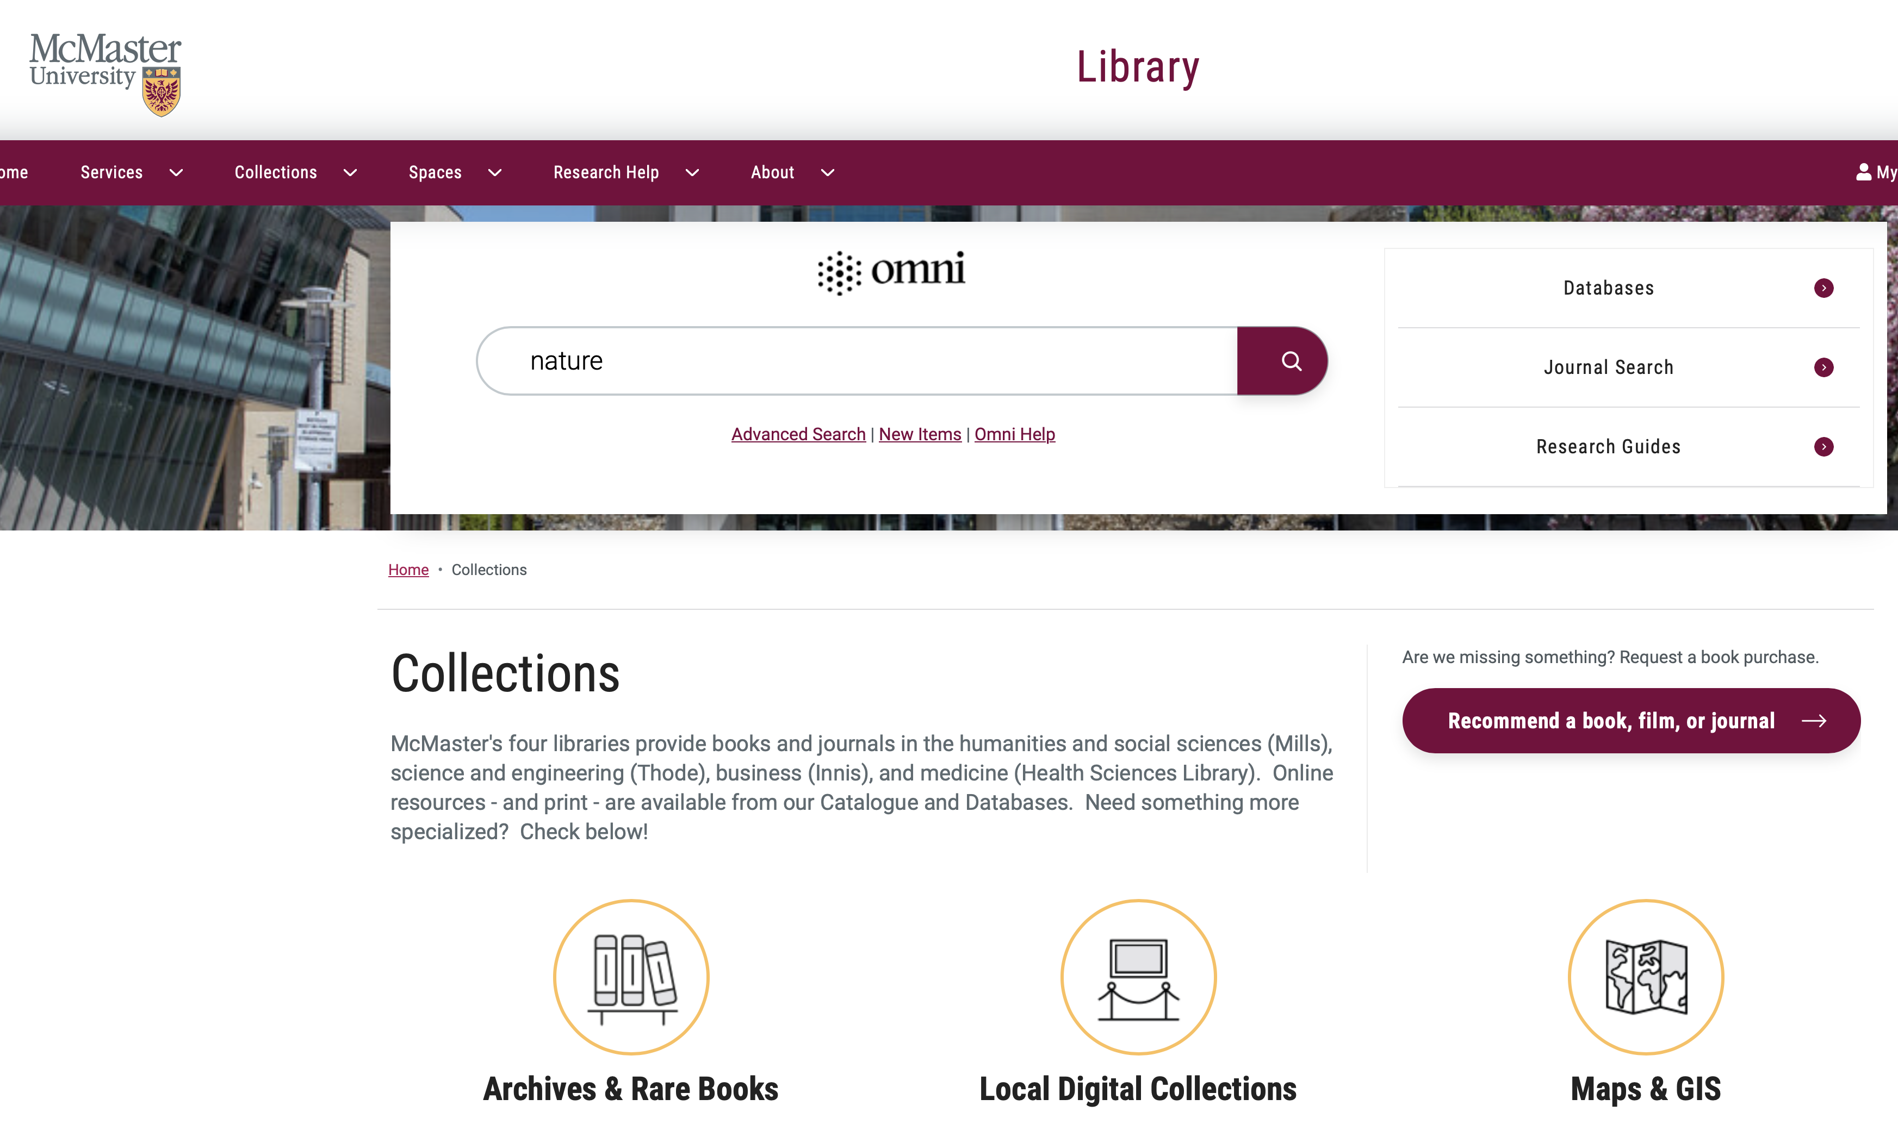
Using PubMed

Slide 32
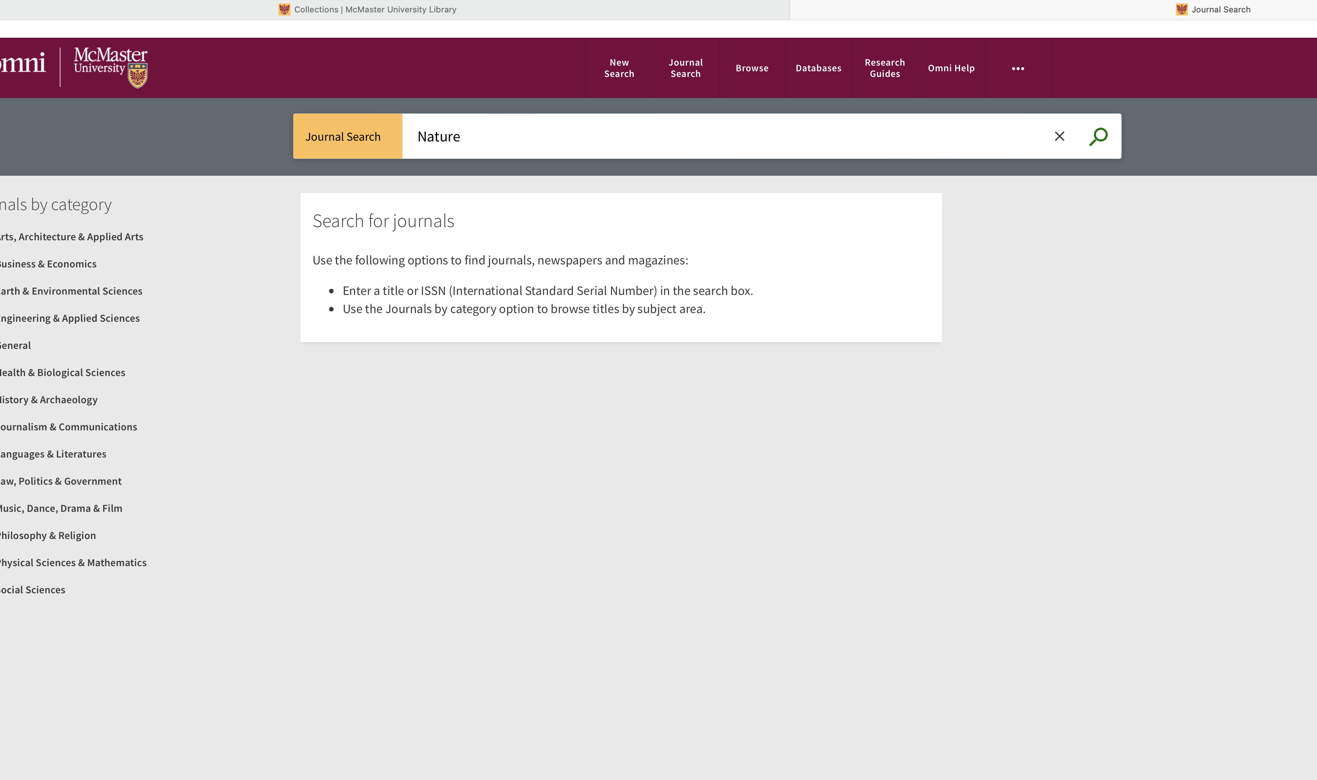
Using PubMed

Slide 33
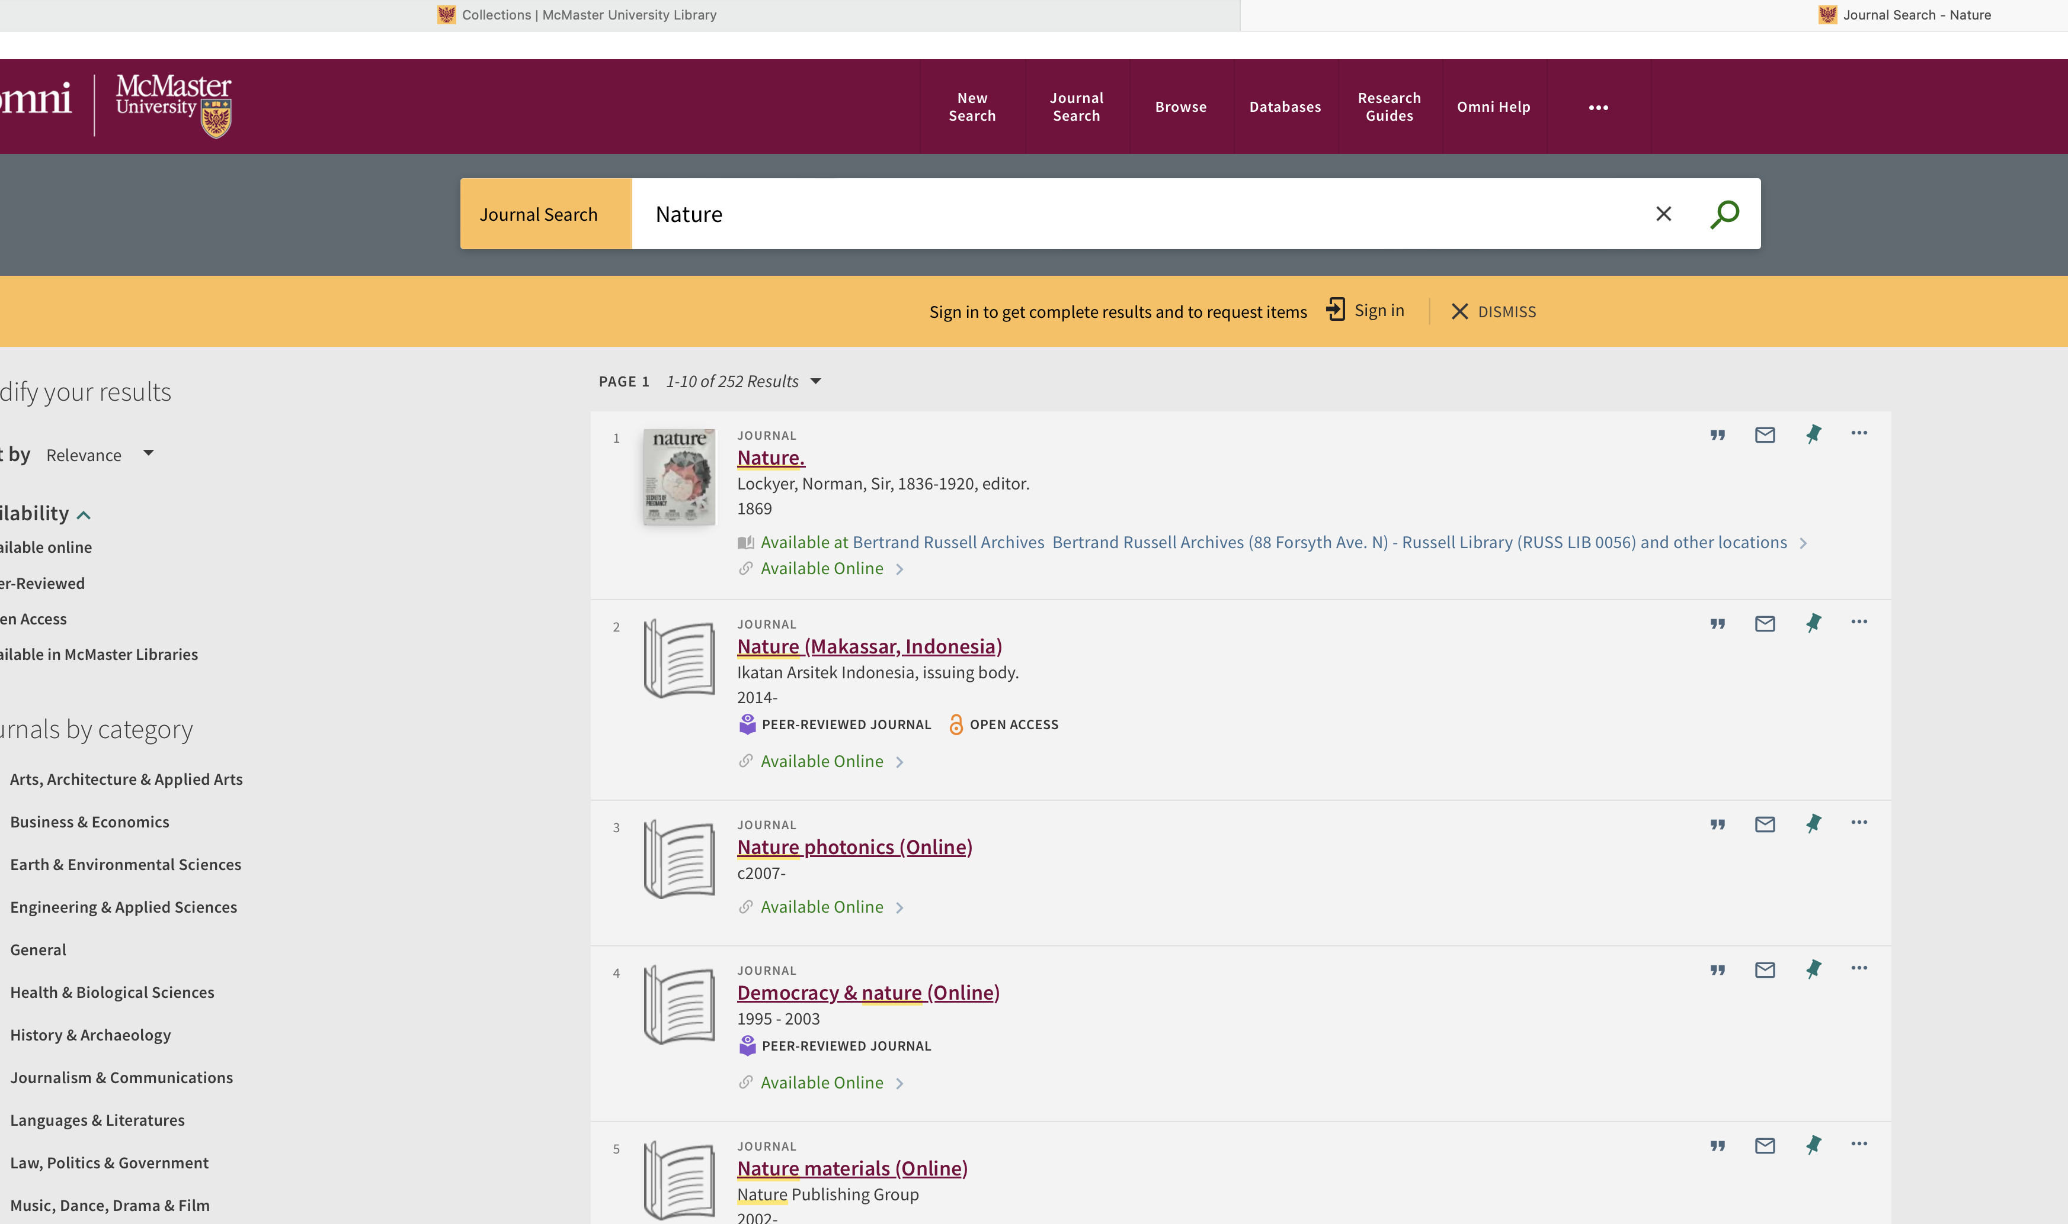
Using PubMed

Slide 34
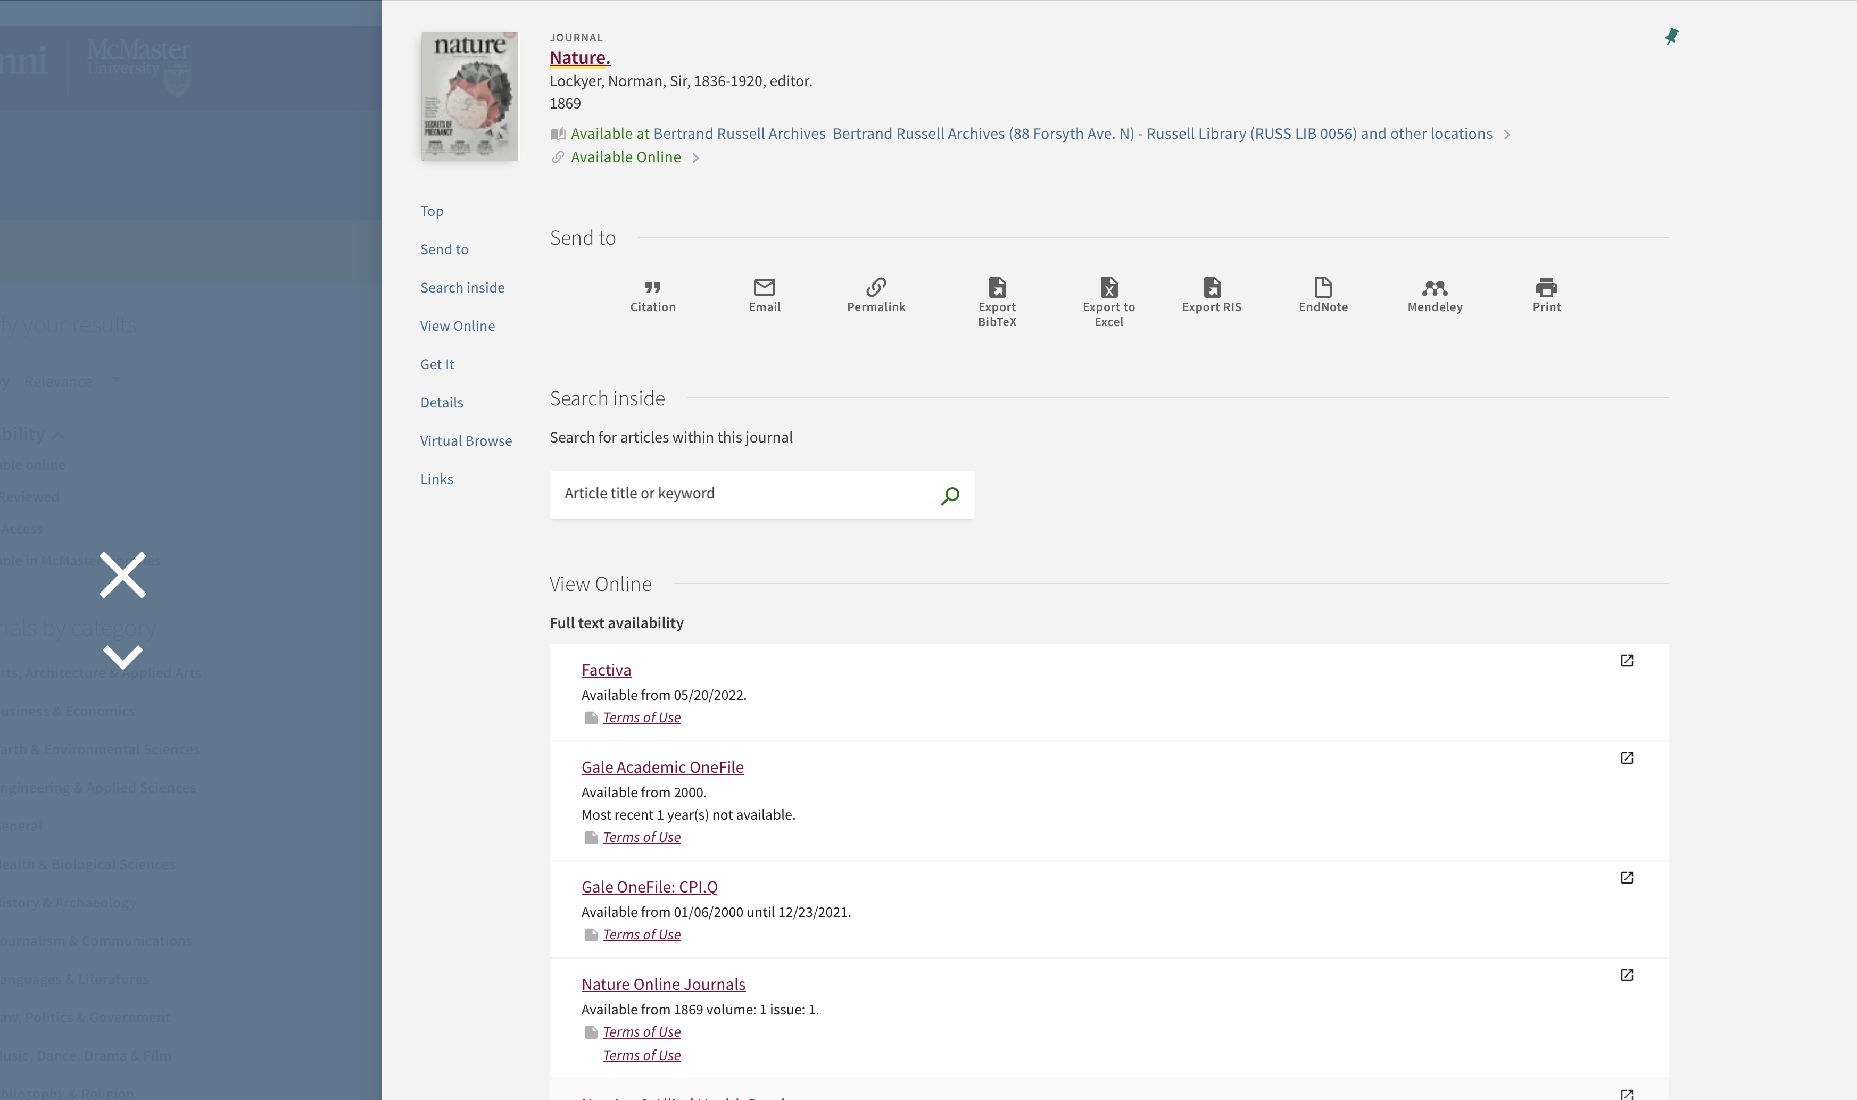
Using PubMed

Slide 35
Bioinformatics
Application of mathematical, statistical, and computational approaches to biological data
Modern emphasis (and emphasis of this course) is upon genomic data, dominated by DNA sequencing.
Yet, bioinformatics is very broad & diverse, for example:
chemoinformatics
protein structure, prediction of ligand binding
whole cell simulation
evolutionary biology
assay development
analytics and machine learning
J. Chang. 2015. Core services: Reward bioinformaticians. Nature 520:151-2.

Slide 36
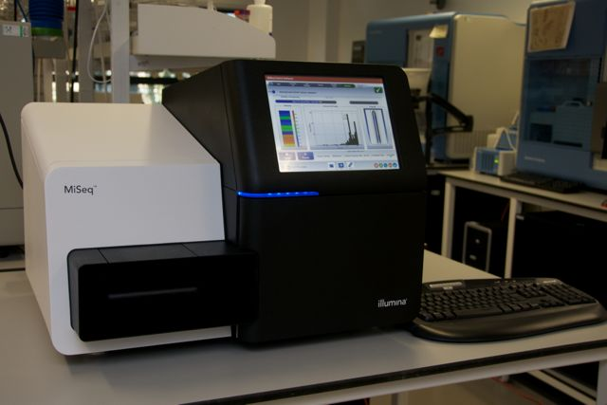
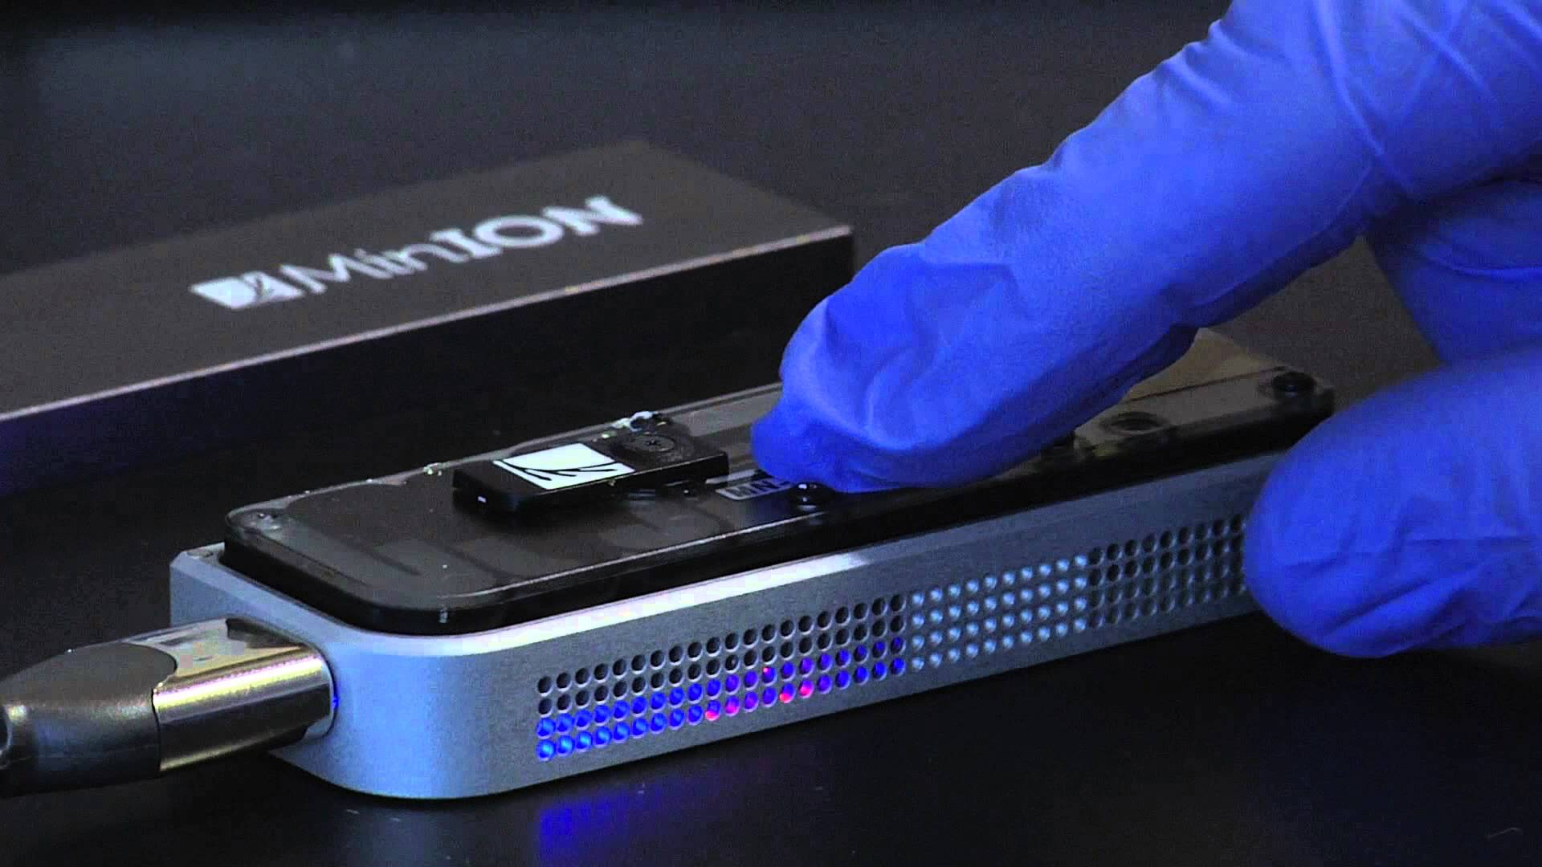
Bioinformatics
Even 10 years ago collecting low- to mid-volume data (e.g. DNA sequencing) was slow and expensive
Now – large scale data collection fast and inexpensive
DNA sequencing is quickly becoming an “assay” – performed by many researchers whose primary goal is not bioinformatics
We now need a balance between bioinformatics labs / core facilities and translating the skill set to researchers in all areas of bioscience
Illumina DNA Sequencer
Nanopore DNA Sequencer

Slide 37
Bioinformatics – Relative Costs
Sboner et al. 2011. The real cost of sequencing: higher than you think! Genome Biol. 12(8):125.
Next Generation Sequencing (NGS) – Low cost, high volume advanced sequencing methods, e.g. Solexa/Illumina massively parallel sequencing
Pre-NGS – High cost, low volume DNA sequencing based on the Sanger sequencing method

Slide 38
Bioinformatics
Bioinformatics can be…
Hypothesis testing using experimentally generated data
Data curation and knowledge integration
Data mining as part of experimental design
There are no ‘one size fits all’ analyses
“Pure” bioinformatics is rare – new algorithm or data schema development
Most bioinformatics is “applied” and highly collaborative
Bioinformaticians need to understand the biology and lab work
This course will survey a number of key applied bioinformatics questions, with an introduction to the underlying theory
The course emphasizes breadth instead of depth
Go deeper...
Bioinformatics 4th year thesis project
Co-Op in a Bioinformatics lab
Graduate school

Slide 39
Bioinformatics
Bioinformatics is one of the data sciences
data – actual measurements and observations
metadata – information on methods, observer ID, date time, etc.
software & algorithms
databases and data formats
computing hardware & networks
Publish and share your data or it might as well not exist!
Permanent identifiers are essential
Follow data and file format standards
Document and share your methods, software & workflows – this is important metadata
Love your data scientist – Biocurators are the underdogs of modern biological research

Slide 40
BioCuration & Databases
Burge et al. 2012. Biocurators and biocuration: surveying the 21st century challenges. Database Mar 20:bar059
One of the most important tools in bioinformatics today is the database
Primary – raw data – DNA sequence, protein structure, chemical structure, gene expression measurements, etc
Secondary – integration of many sources of primary data, often organism-specific (e.g. Drosophila DB) or area specific (e.g. drug-drug interaction DB)
Literature curation (human or automated) and higher-level conceptual organization of knowledge (e.g. ontologies) increasingly important

Slide 41
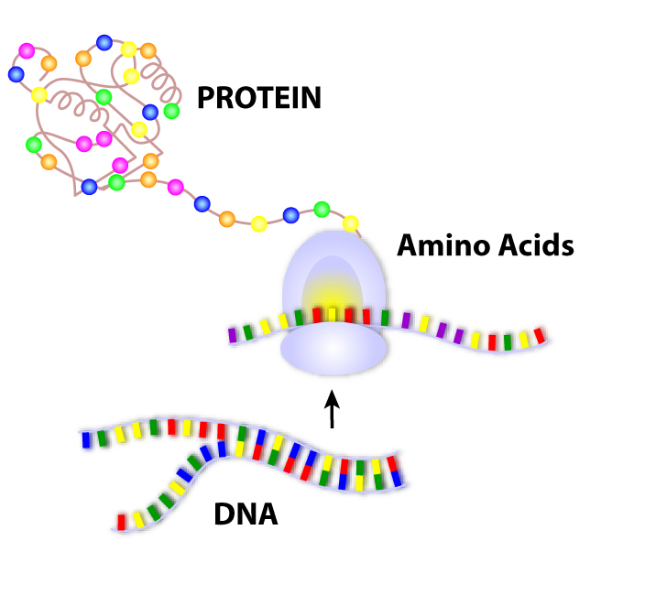
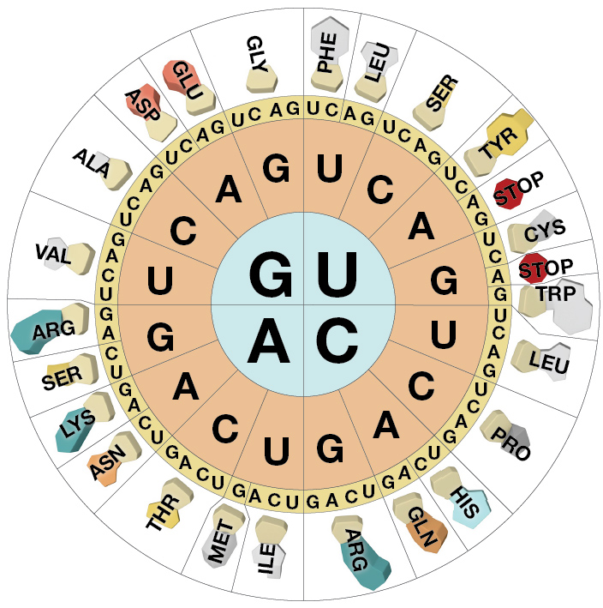
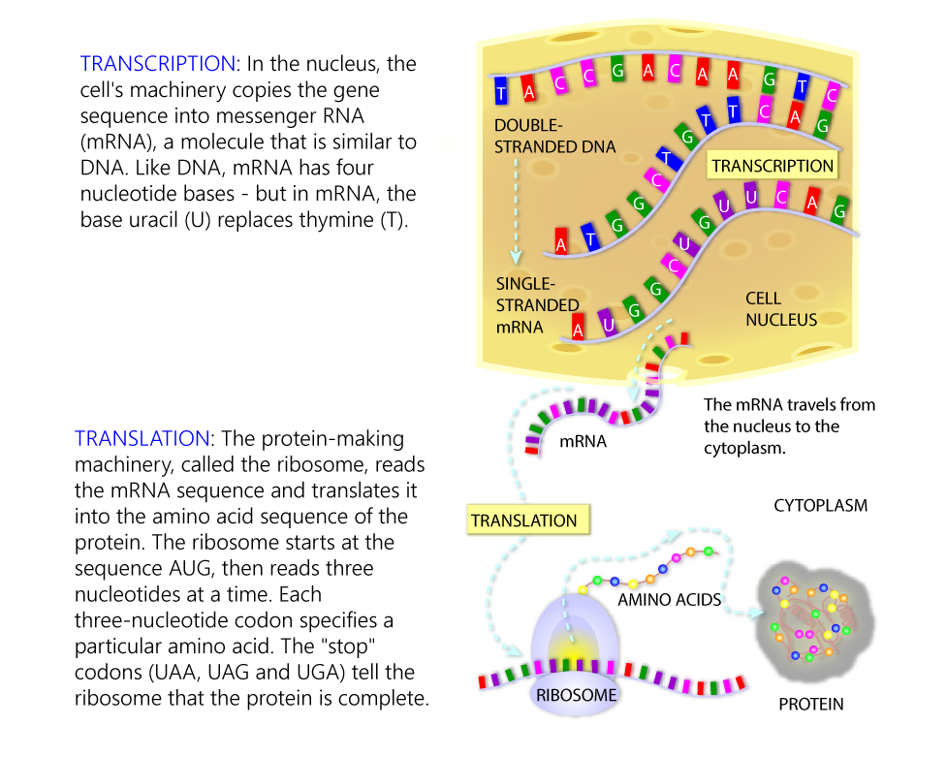
Next Week’s Lab focuses on Databases
Central Dogma
Images from "Genetic Science Learning Center, University of Utah, http://learn.genetics.utah.edu."
adenine and guanine are purines
cytosine, thymine, and uracil are pyrimidines

Slide 42
Next Week’s Lab focuses on Databases
Moore’s Law (computer processor speed doubles every 18 months) and Kryder’s Law (disk storage capacity doubles every 14 months) are critical to the future of biological research, see http://www.scientificamerican.com/article/kryders-law/
Will advances in DNA sequencing outstrip Moore’s and Kryder’s law?
NGS
Sboner et al. 2011. The real cost of sequencing: higher than you think! Genome Biol. 12(8):125.
Stein. 2010. The case for cloud computing in genome informatics. Genome Biol. 11(5):207.

Slide 43
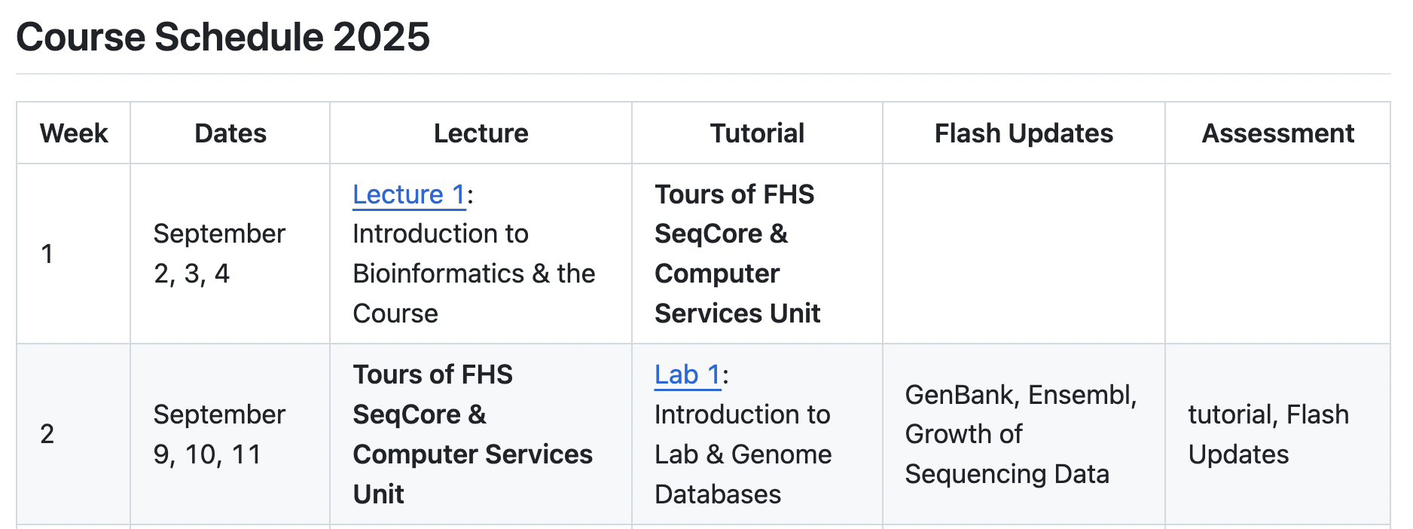
This week & next...

Slide 44
This week & next...

